Slide 1
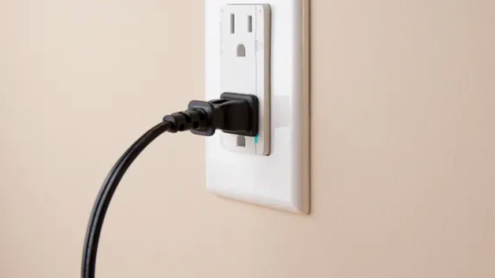
Wall power
By Abdulrahman Alrudayan

Slide 2
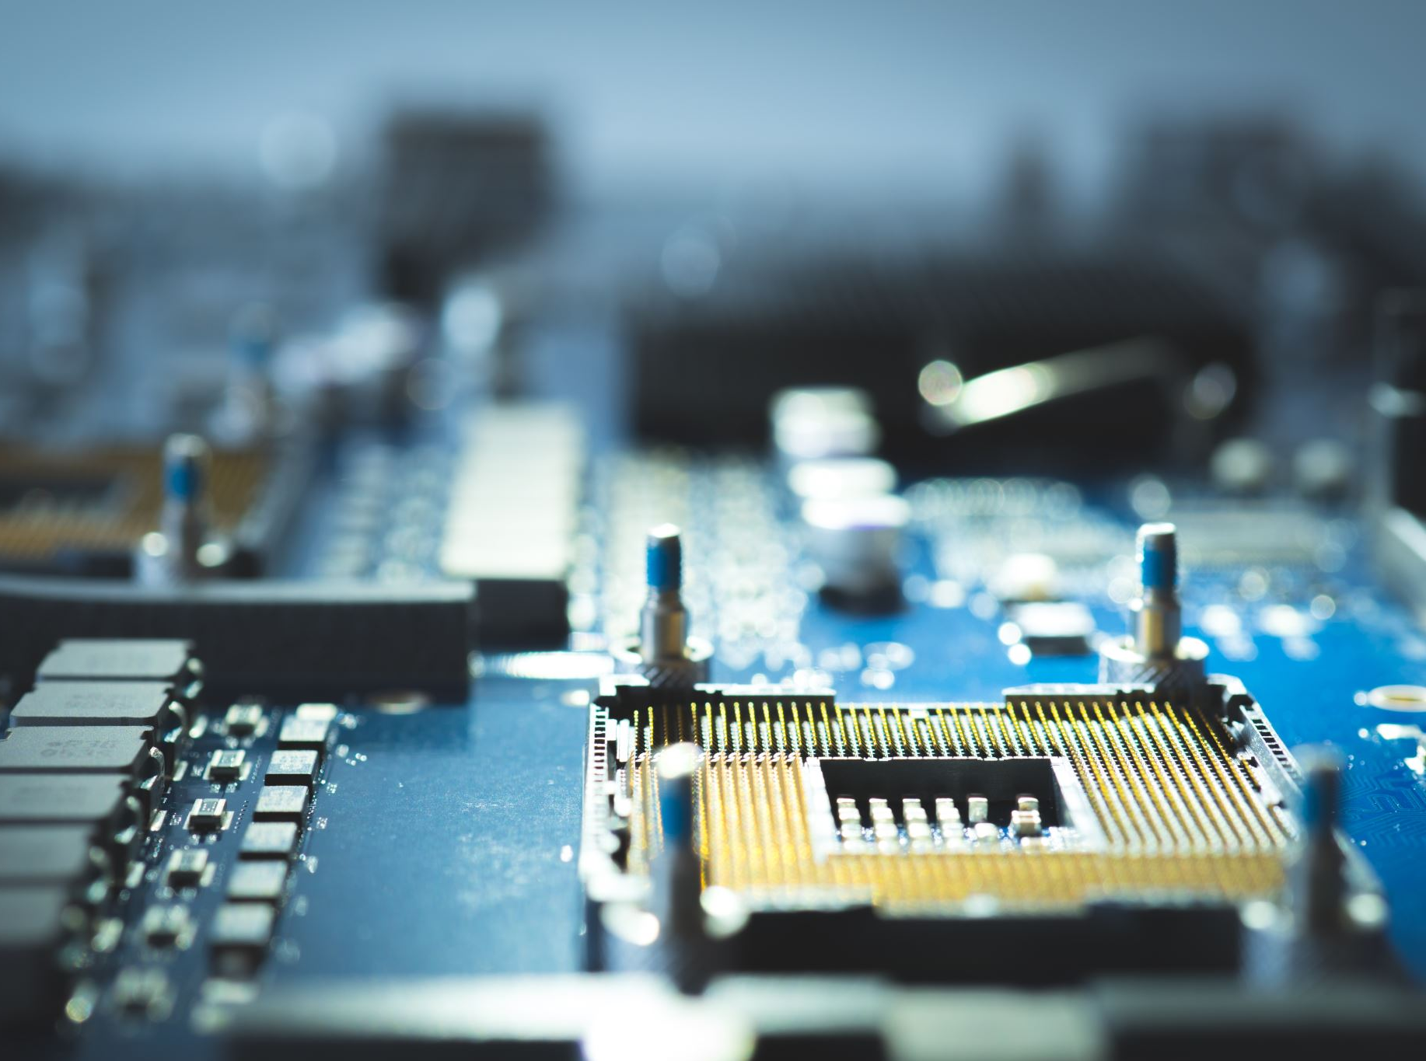
What the process?
Adapter Power Supply AC to DC Plug
Converters Buck
Backup Battery 12v
Relay switch
Kill switch

Slide 3
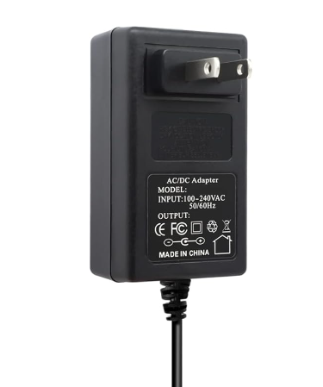
Main Wall Power Subsystem
Adapter Power Supply:
Converts AC to 12V DC

Slide 4
Buck Converters:
Step down the voltage
First subsystem “Data interpretation and Storage” : To +5.5V DC, 0.25A
Second subsystem “Sensor” : To +9V DC, 0.05A

Slide 5
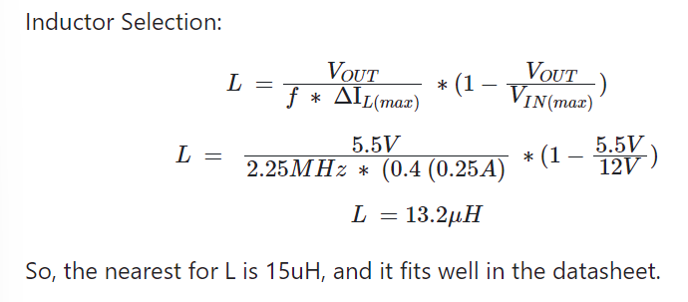
Selecting and size
First subsystem
Buck Converter : LTC3621
First subsystem “Data interpretation and Storage” : To +5.5V DC, 0.25A

Slide 6
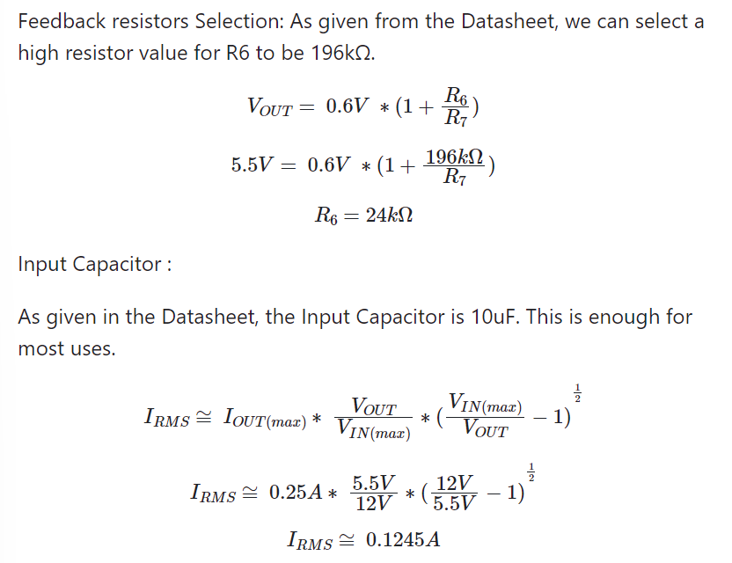
Feedback resistors Selection and Input Capacitor :
Output Capacitor: As given in the Datasheet, the Input Capacitor is 22uF.

Slide 7
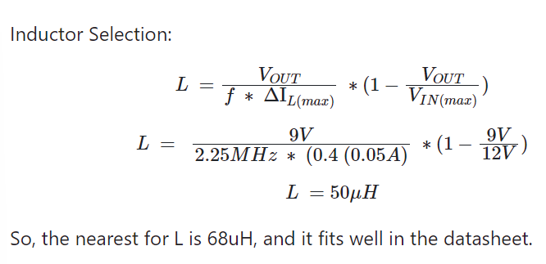
Selecting and size
Second subsystem : Sensor

Slide 8
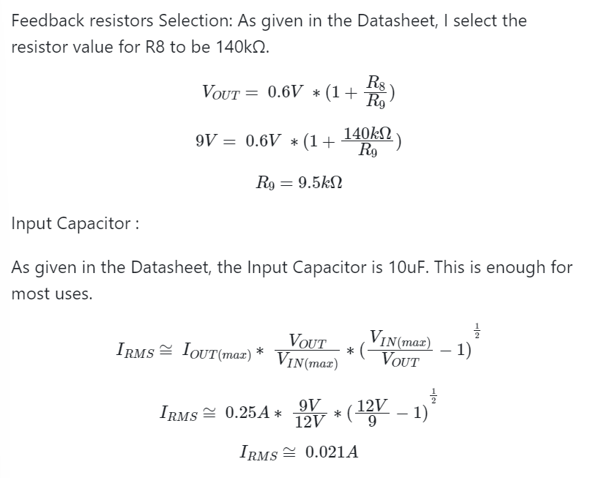
Feedback resistors Selection and Input Capacitor :
Output Capacitor:
As given in the Datasheet,
the Input Capacitor is 22uF.
This is best for use.

Slide 9
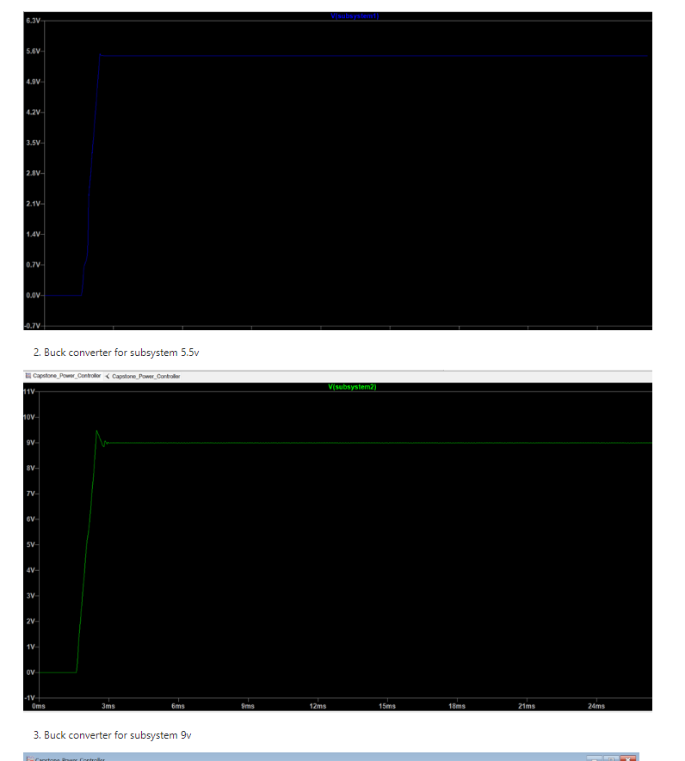
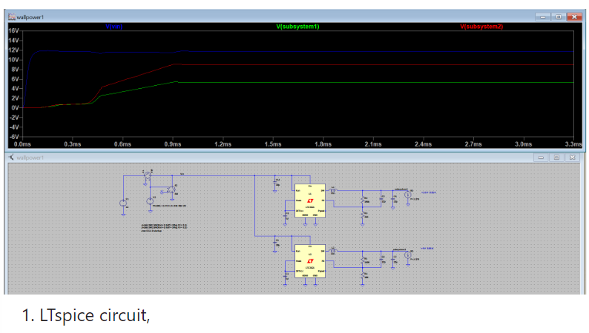
LTspice

Slide 10
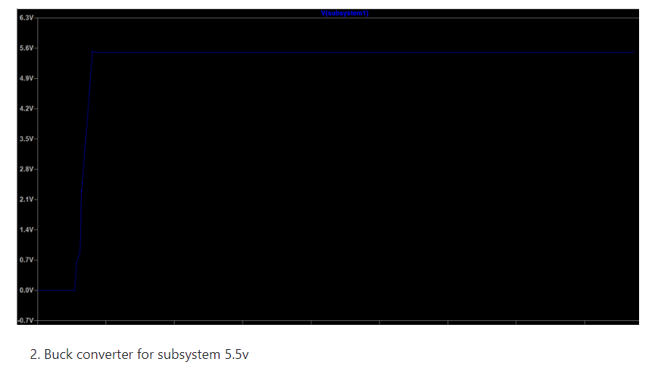
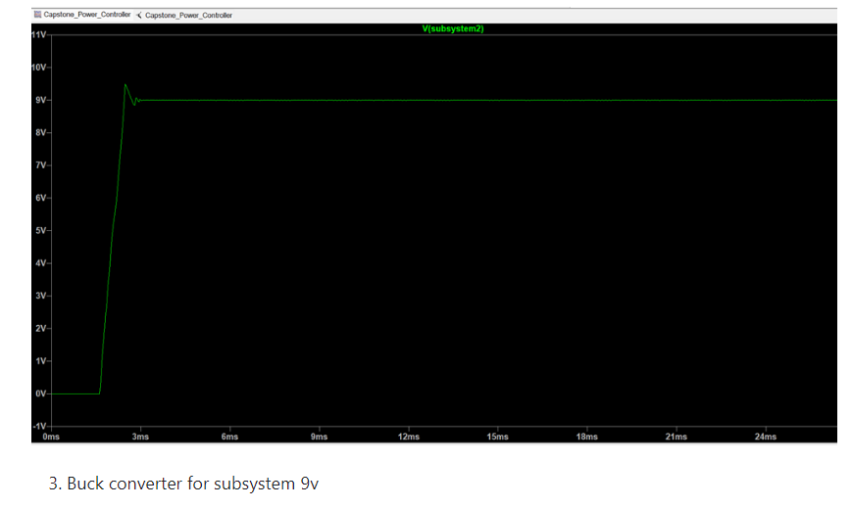

Slide 11
Controller:
Manage power flow between main wall power and backup power
Used relay to switch between power
Kill switch for safety

Slide 12
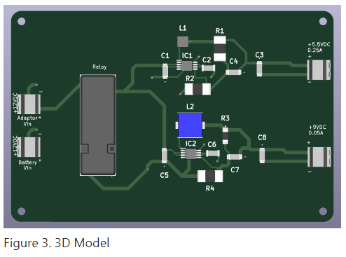

Slide 13
Thank you !

